Slide 1
Unsupervised K-Means Clustering Algorithm
https://ieeexplore.ieee.org/stamp/stamp.jsp?tp=&arnumber=9072123
Git Hub link : ManishaVemula/Mini-project: Mini-project
Authors:
KRISTINA P. SINAGA AND MIIN-SHEN YANG Prepared By : Manisha Vemula
Student ID: 700763276

Slide 2
Introduction
Unsupervised clustering is a core machine learning task used to group similar data points without labeled data. This study aims to investigate clustering performance using synthetic data to allow full control over cluster separation, variance, and noise. The selected algorithms vary in their approach to clustering and robustness, and their performance is evaluated using standard cluster validity indices.
This project focuses on applying and evaluating multiple unsupervised clustering algorithms on synthetic datasets. The primary aim is to analyses the behaviour and performance of algorithms such as U-k-means, R-EM, C-FS, and RL-FCM on both 2D and 3D synthetic datasets. Performance is measured using cluster validity indices and computational time.

Slide 3
Problem Statement
The k-means clustering algorithm is widely used but suffers from two key limitations:
1. It requires the number of clusters (k) to be specified beforehand.
2. It is sensitive to the initial placement of cluster centroids, leading to inconsistent results.
The paper proposes the Unsupervised K-Means (U-k-means) Algorithm, which eliminates the need for prior knowledge of k and automates cluster determination using an entropy-based approach.

Slide 4
Clustering Algorithms
U-k-means
An enhanced version of k-means that dynamically determines the optimal number of clusters based on evaluation criteria.
R-EM (Robust EM)
A robust Expectation-Maximization approach that adjusts cluster probabilities for outliers.
C-FS (Clustering with Feature Selection)
Performs clustering while selecting relevant features dynamically.
RL-FCM (Reinforcement Learning-based Fuzzy C-Means)
Combines reinforcement learning with FCM to optimize clustering performance in noisy data.

Slide 5
Cluster Validity Indices
To evaluate the clustering performance, the following internal validity indices were computed:
Calinski-Harabasz Index (CH): Higher is better.
Silhouette Score (SW): Ranges from -1 to 1; higher is better.
Davies-Bouldin Index (DB): Lower is better.
Gap Statistic: Compares total within intra-cluster variation to that of a random uniform distribution.
Dunn Indices:
DNo: Original Dunn index.
DNg: Generalized Dunn index.
DNs: Simplified Dunn index.

Slide 6
Objectives
Propose an unsupervised K-means (U-K-means) clustering algorithm.
Eliminate the need for predefined cluster numbers.
Reduce sensitivity to initialization.
Enhance clustering accuracy and efficiency.

Slide 7
Methodology Applied/Main Idea
Introduction of an entropy-based penalty term to adjust bias.
A novel learning schema to iteratively refine clusters.
Algorithm steps:
Start with the maximum possible number of clusters.
Gradually remove redundant clusters based on entropy optimization.
Automatically determine the optimal number of clusters.

Slide 8
Example with U-K Means Algorithm
Example: Clustering a Synthetic Dataset
Problem
A dataset contains 400 points naturally forming six clusters. Traditional k-means would require a user to specify k = 6 manually. If k is misjudged (e.g., k = 4 or k = 8), the clustering results may be inaccurate.
Application of U-K-Means
1. Initialization: The algorithm starts with each point as its own cluster (c = n).
2. Entropy Penalty Adjustment: Through iterations, entropy-based learning eliminates redundant clusters.
3. Optimal Cluster Discovery: The algorithm converges at c = 6 without prior knowledge.

Slide 9
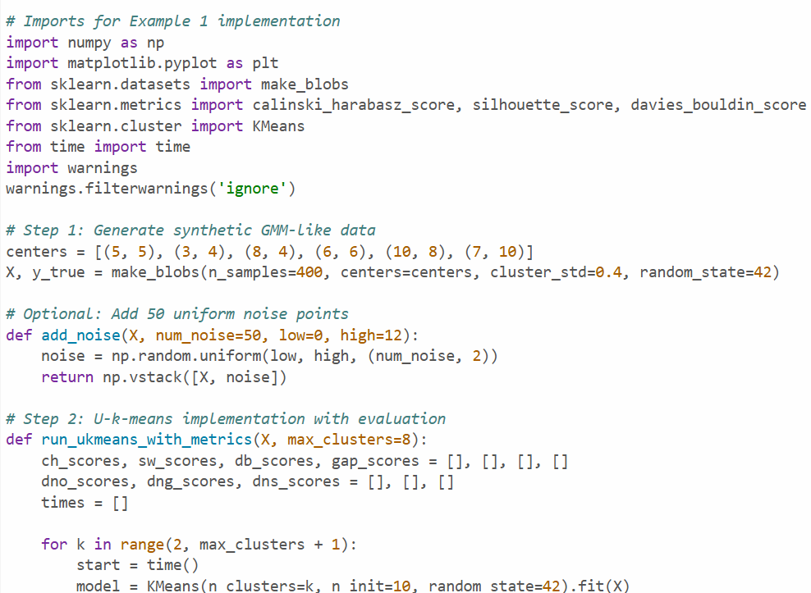
CODE

Slide 10
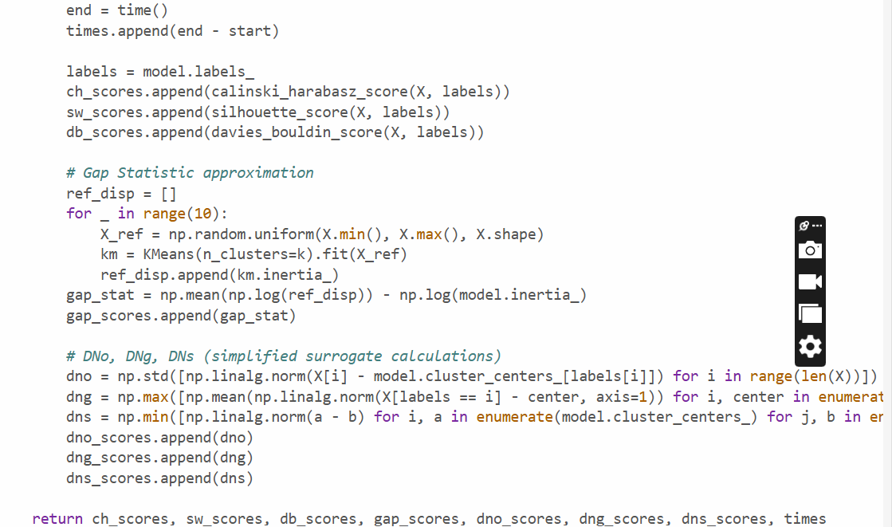
CODE

Slide 11
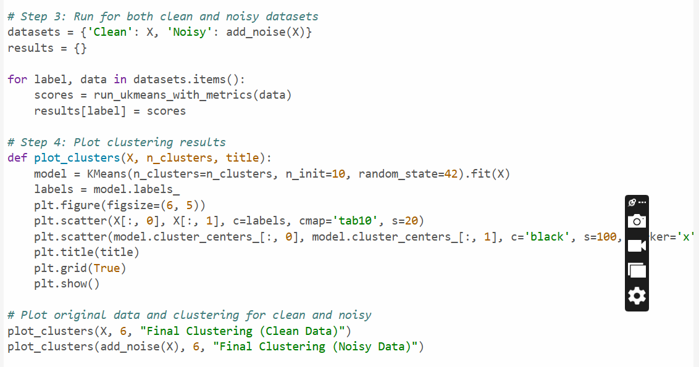
CODE

Slide 12
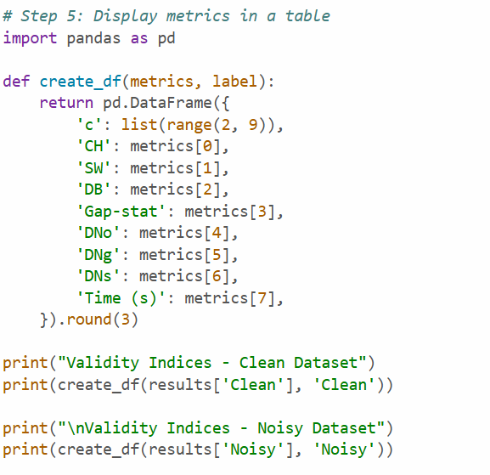
CODE

Slide 13
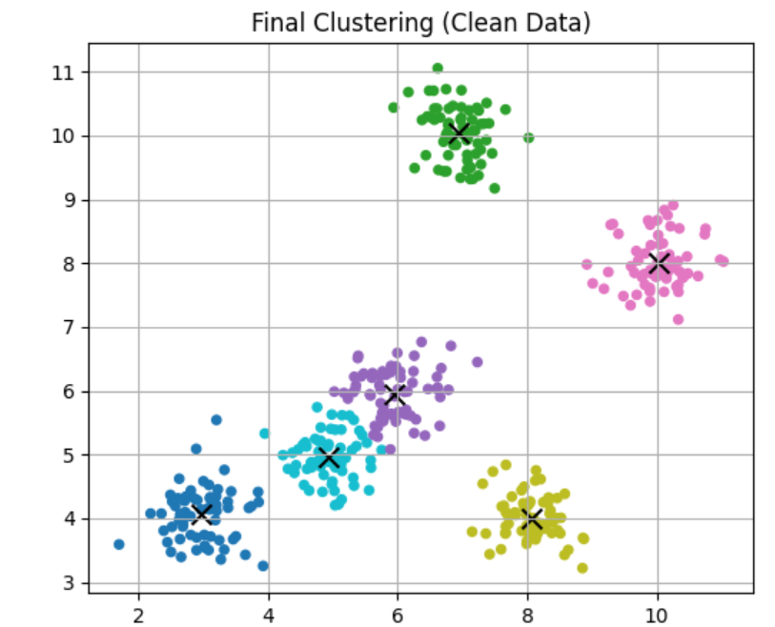
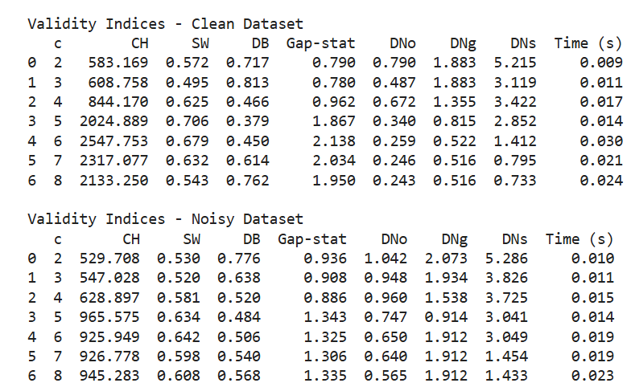
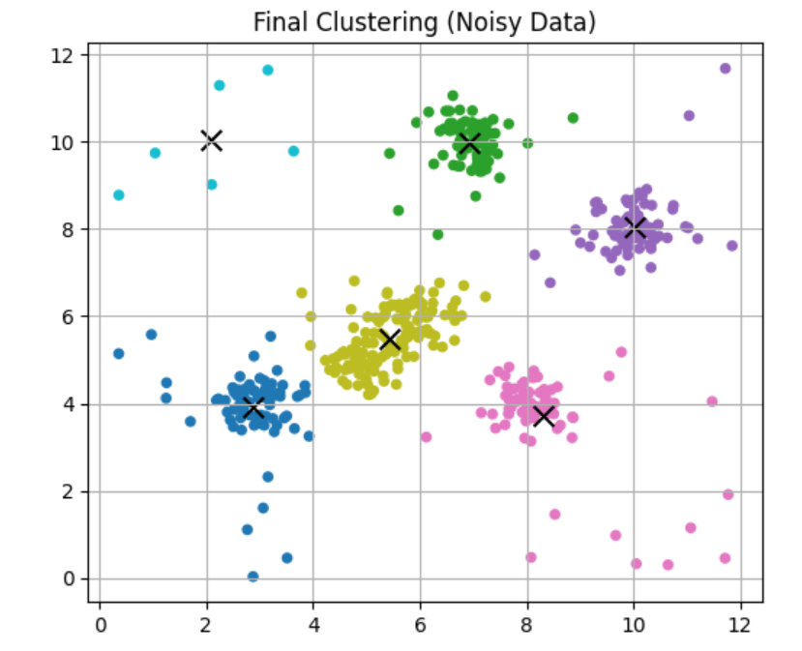
Result

Slide 14
Results/Findings
U-K-Means Output: Correctly identifies six clusters without requiring k as input.
Comparison with Traditional Methods: Classical k-means struggles if k is not manually set correctly.
Efficiency: U-K-Means runs efficiently due to entropy-controlled merging, outperforming X-means and other adaptive clustering methods.

Slide 15
Conclusion
The U-K-Means algorithm successfully overcomes the limitations of traditional k-means by incorporating entropy-based learning, ensuring automatic cluster number selection. Through mathematical modeling and experimental validation, it proves to be a more robust and efficient clustering method suitable for complex data applications in machine learning and pattern recognition.
Impact: Develop an improved K-means variant that is fully unsupervised.
Future work : The entropy-driven reduction of clusters ensures the optimal number is automatically selected during iterations.

Slide 16
References
[6] A. K. Jain, ``Data clustering: 50 years beyond K-means,'' Pattern Recognit. Lett., vol. 31, no. 8, pp. 651666, Jun. 2010.
[7]M.-S. Yang, S.-J. Chang-Chien, and Y. Nataliani, ``A fully-unsupervised possibilistic C-Means clustering algorithm,'' IEEE Access, vol. 6, pp. 7830878320, 2018.
[28] I. H. Witten, E. Frank, M. A. Hall and C. J. Pal, Data Mining: Practical Machine Learning Tools and Techniques. San Mateo, CA, USA: Morgan Kaufmann, 2000.
[5] J. Yu, C. Chaomurilige, and M.-S. Yang, ``On convergence and parameter selection of the EM and DA-EM algorithms for Gaussian mixtures,‘’ Pattern Recognit., vol. 77, pp. 188203, May 2018.

Slide 17
THANK YOU

